Slide 1
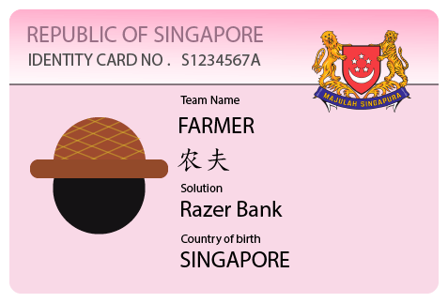
Razer Bank
Team Farmer
https://bank.ntucbee.click
Notes:
Team Members:
Goh Yu Xin
yuxin.goh.2017@smu.edu.sg
Sim Cher Boon
cherboonsim.2017@sis.smu.edu.sg

Slide 2
About us
Sim Cher Boon
Singapore Management University
3rd Year Student
Software Development
Goh Yu Xin
Singapore Management University
3rd Year Student
Software Development

Slide 3





Problem Statement
“Customers are frustrated with the arduous, physical-branch-only user experience and painstakingly long processes in creating accounts and receiving loans”
Well almost all of them… Already have iBanking...
That includes using MyInfo to register as well...
The list goes on...

Slide 4

How can we do better?
Client engagement
Fast
Approval
SIMPLIFIED
USAGE
Engage clients in the same portal that they do their transactions! This subtly encourages them to use the portal!
In today’s era, many decision parameters can be data driven. Instant approval of accounts should be the most basic functionality of a modern bank.
No more confusing buttons. Do what you need at your fingertips!

Slide 5
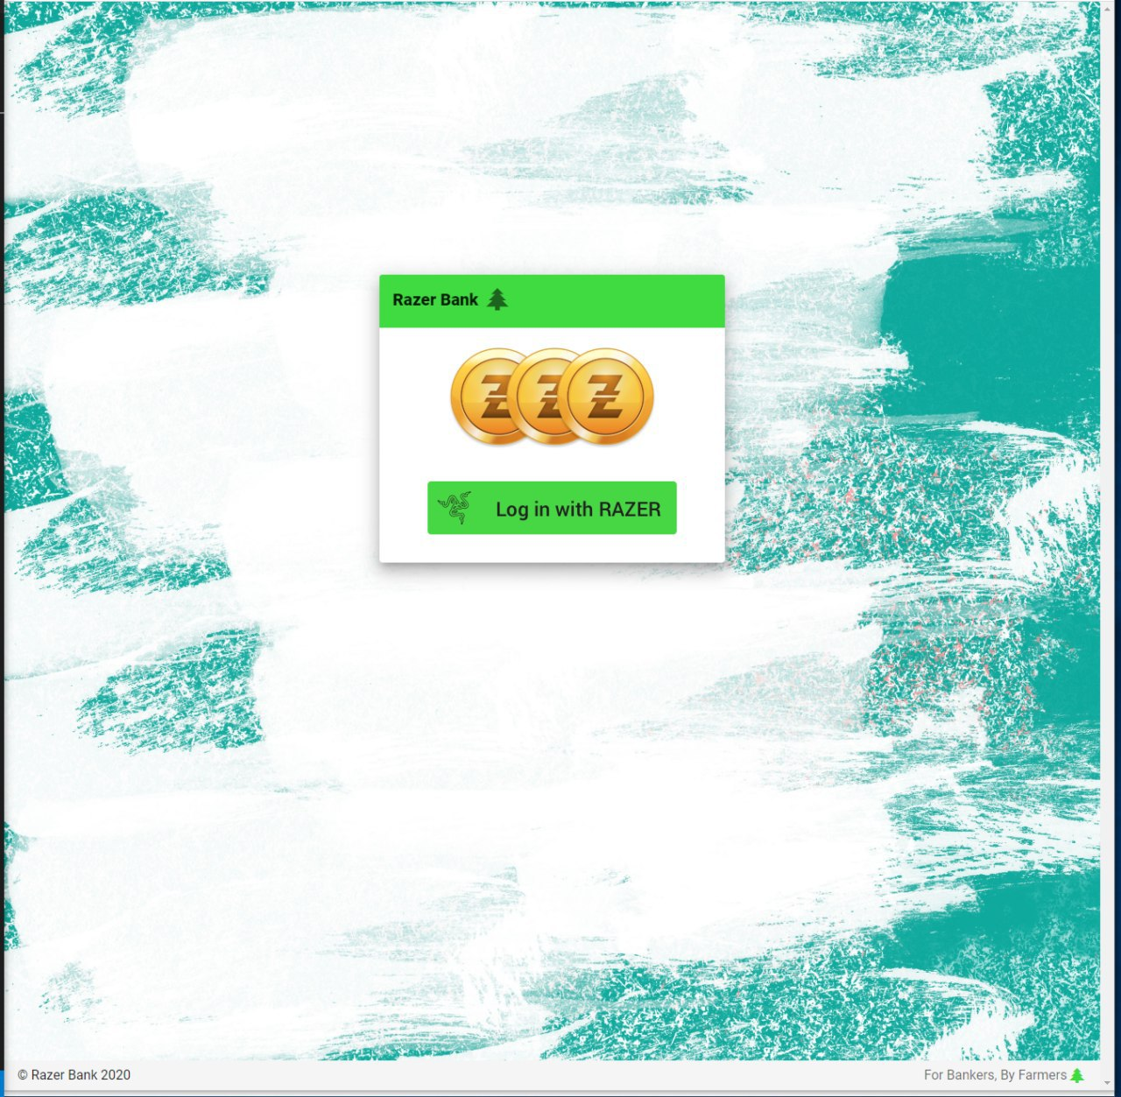
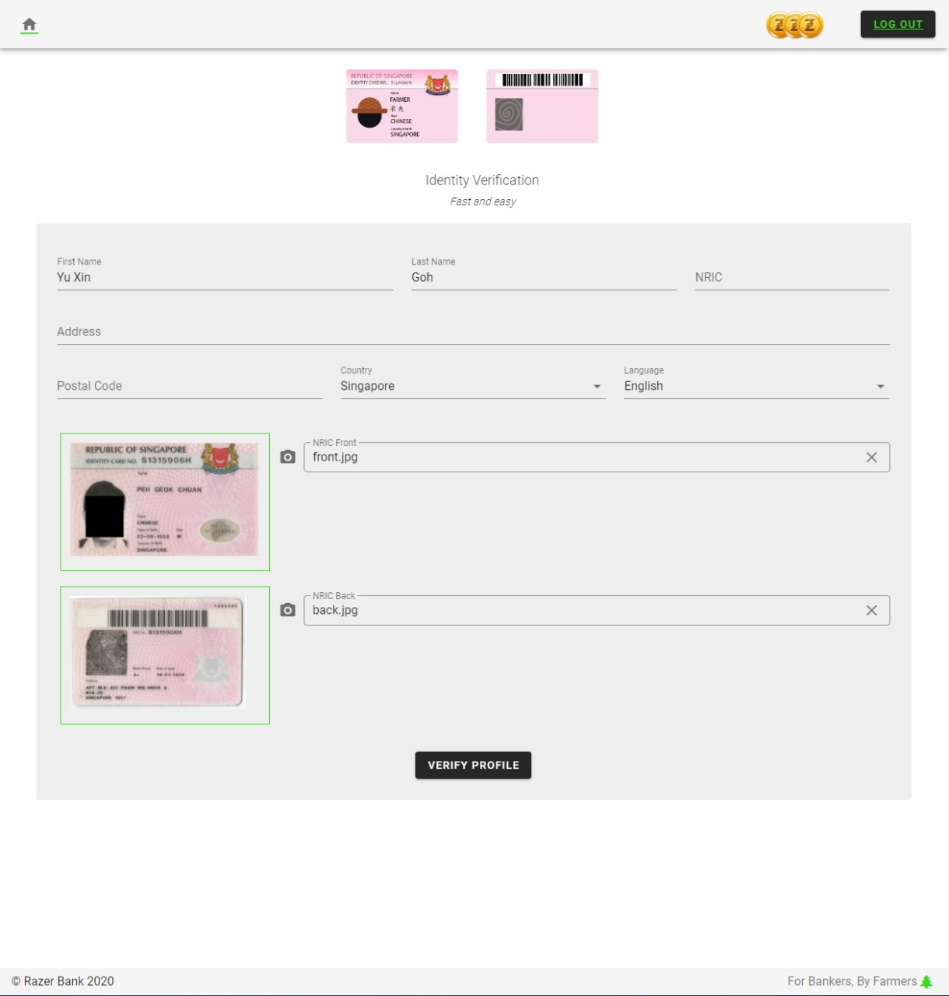
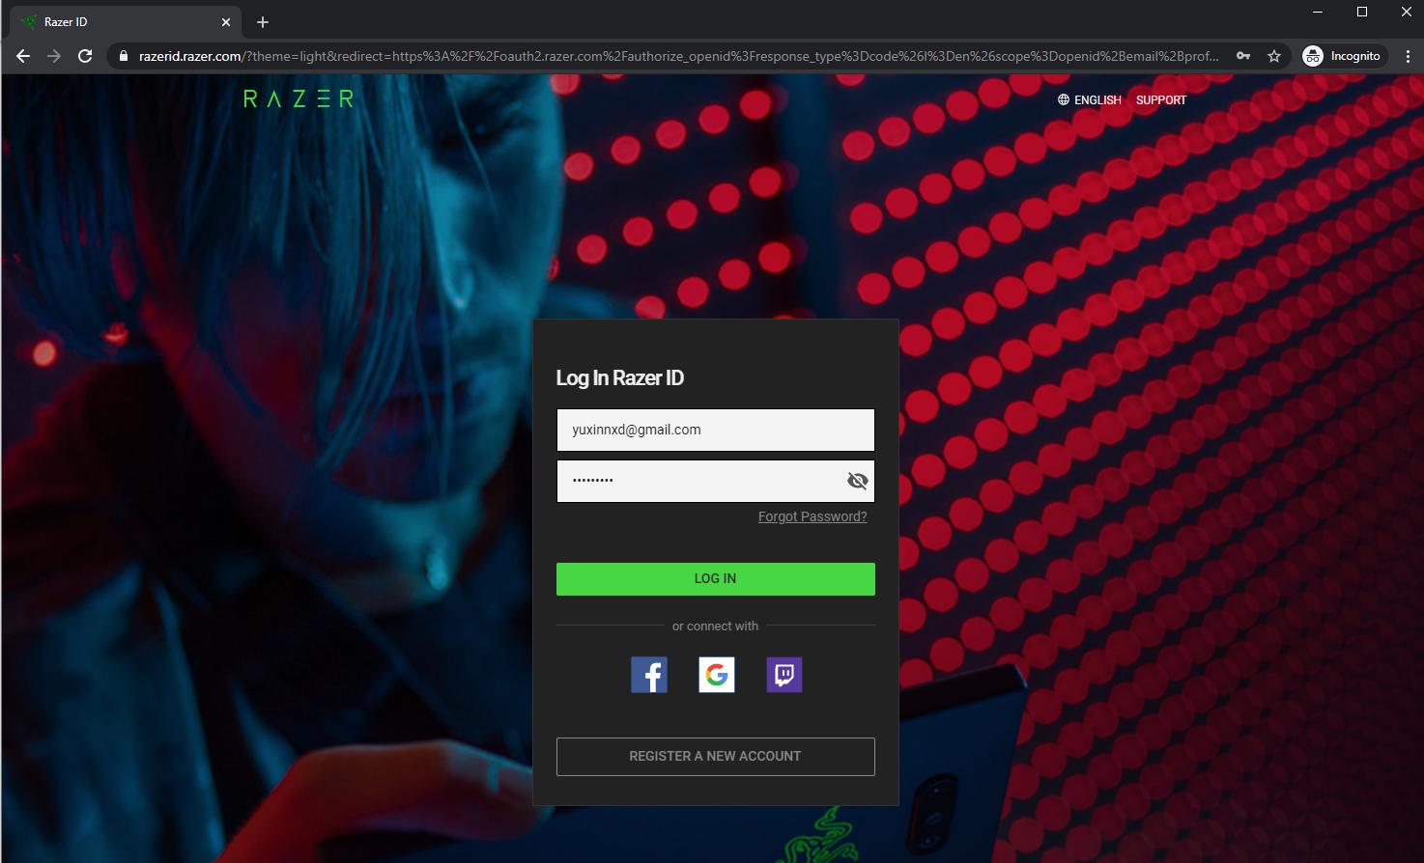
User Interface
Log in with Razer
Identity Verification
Notes:
Our application utilizes razer login, unlike traditional digital banking which requires a username and password.
First time users have to verify their identity by filling up a form with their personal details and attaching a matching NRIC front and back photo. Verification is effortless and provides a smooth experience Only verified users are able to start their banking experience.

Slide 6
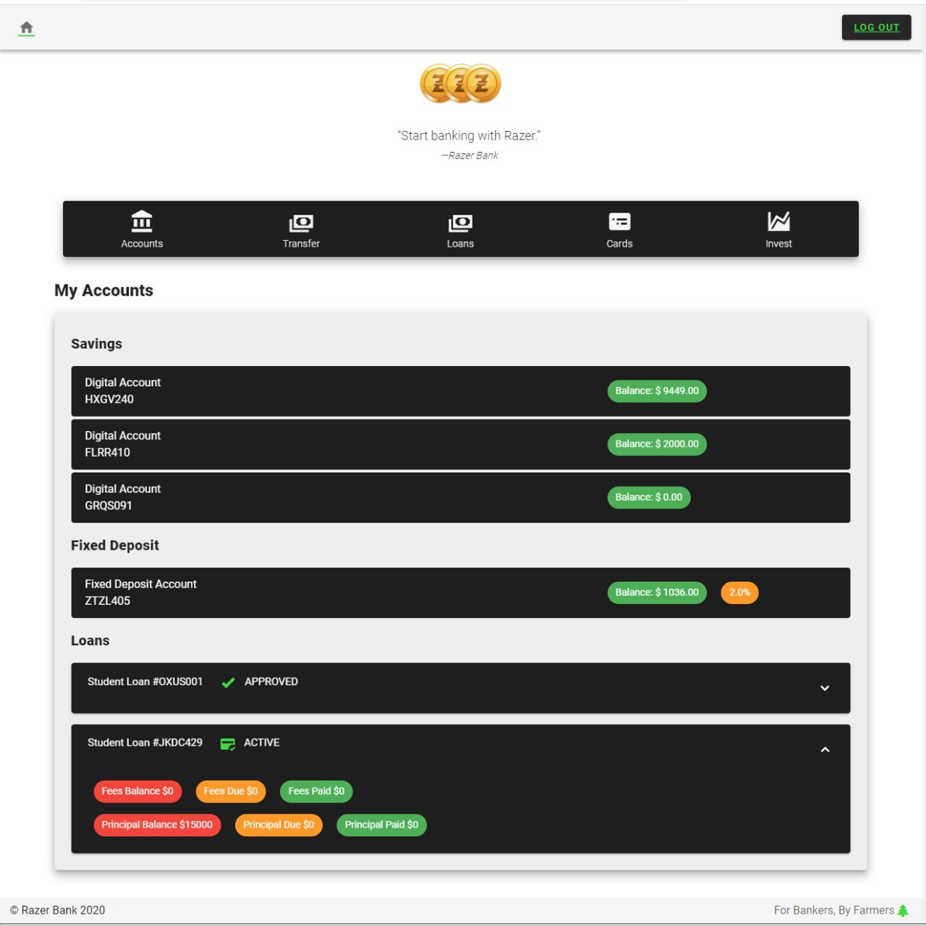
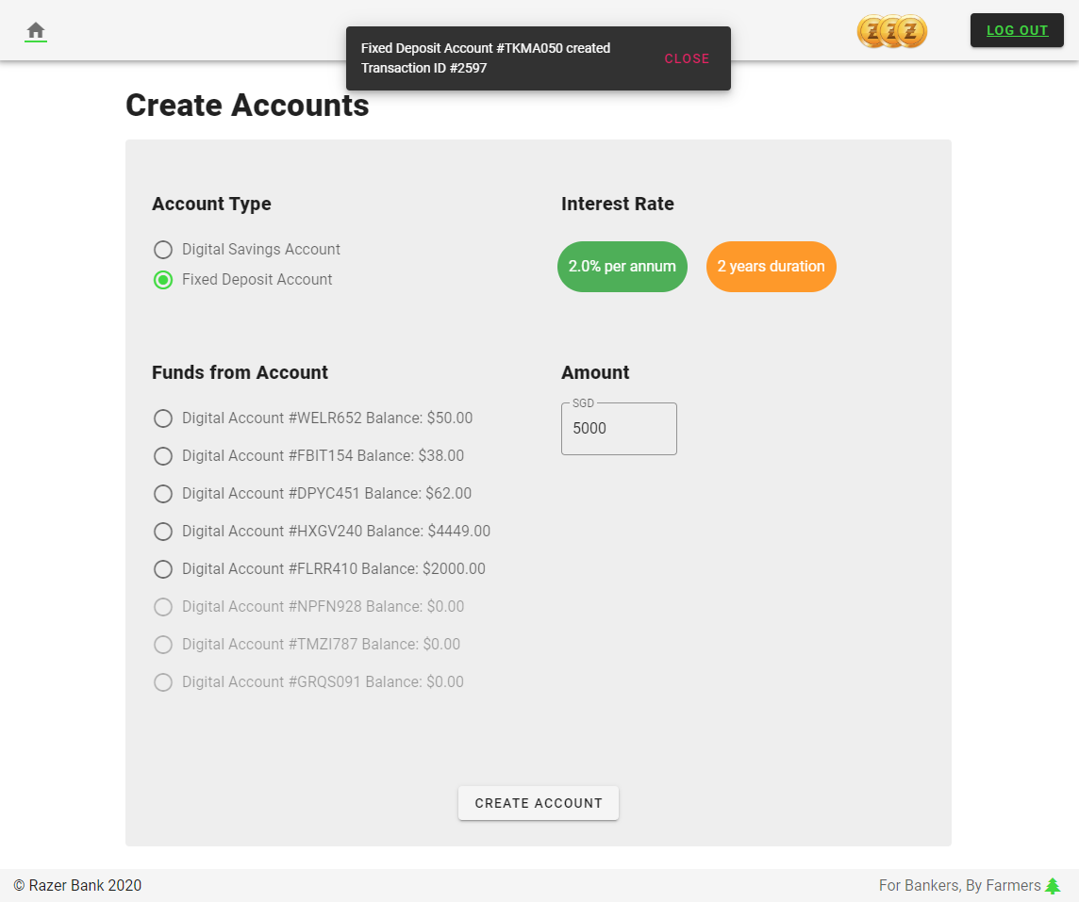
Account Dashboard
Account Opening
Notes:
Upon login, a user will be presented with an overview of their different accounts, showing their account type, balances and status.
Clicking on the “Accounts” icon on the menu redirects the user to the account opening page whereby a user is allowed to create either a savings or deposit account.
Opening a fixed deposit account would have its initial funds taken from a bank account selected.
For demo purpose, a newly created savings account would by default have an initial balance of $500. This is to allow the demo of fund transfer.

Slide 7
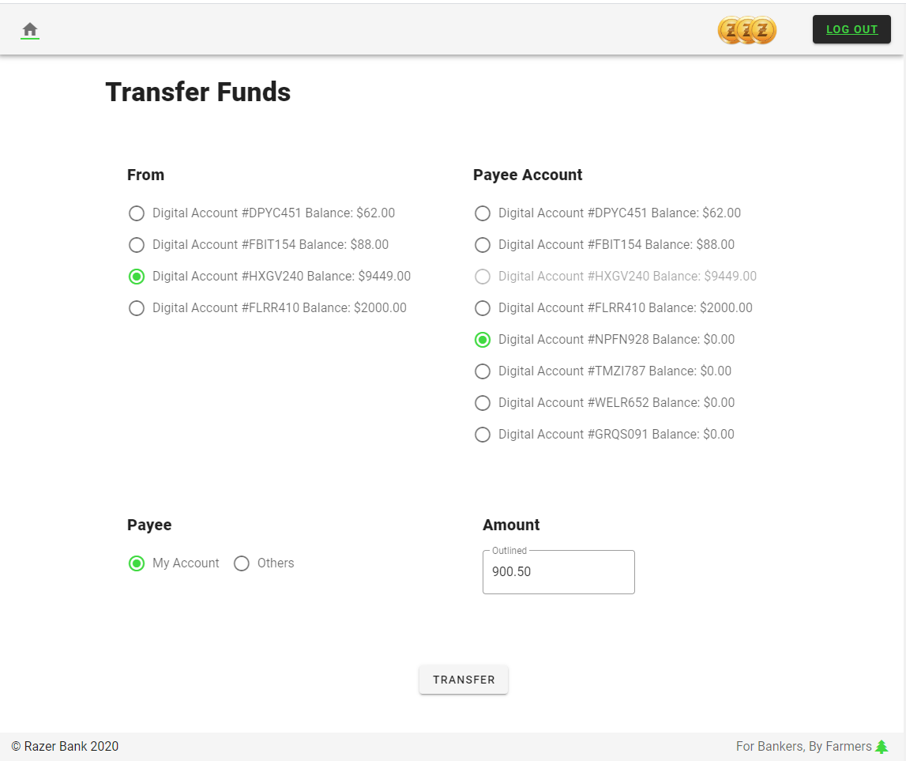
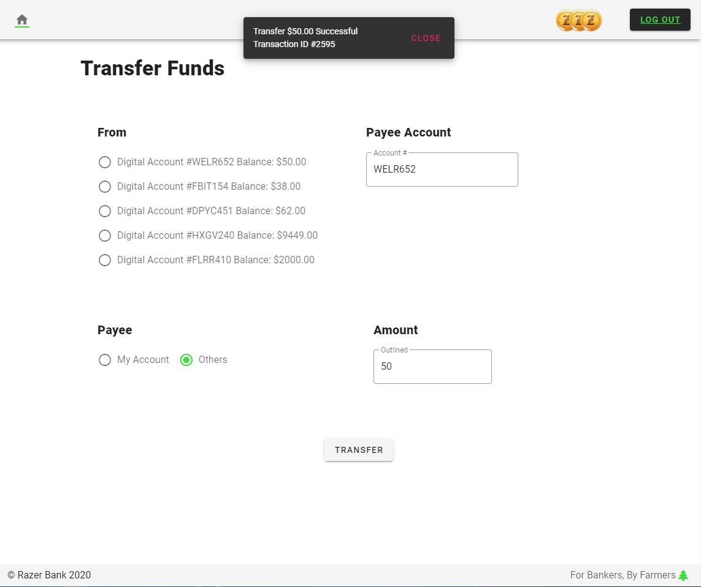
Fund Transfer
Notes:
Transferring of funds between a client’s accounts or external accounts are within the same page and can be done in just a few button clicks. A successful transfer will be alerted along with the amount and transaction id.
P.S. An account without money is unable to transfer funds, hence for demo purpose a savings account created online has an initial value of $500.

Slide 8
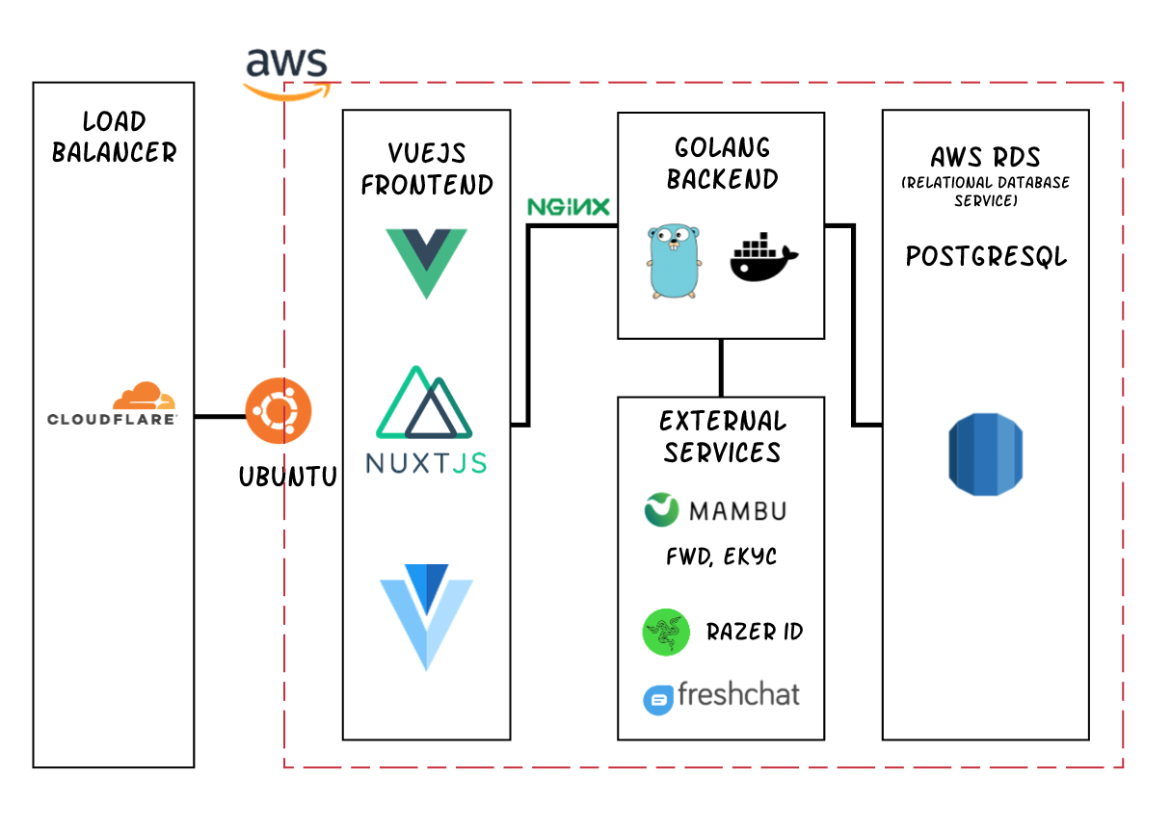
The Tech Stack
Notes:
Our team took on a service oriented architecture, using a decoupled frontend and backend.
The frontend is served in VueJS, and is built on top of NuxtJS, using frameworks from Vuetify.
The backend is coded in Golang and containerized using Docker.
The database is provided by AWS RDS using PostgreSQL.
The solution is hosted on Amazon Web Services (AWS).

Slide 9
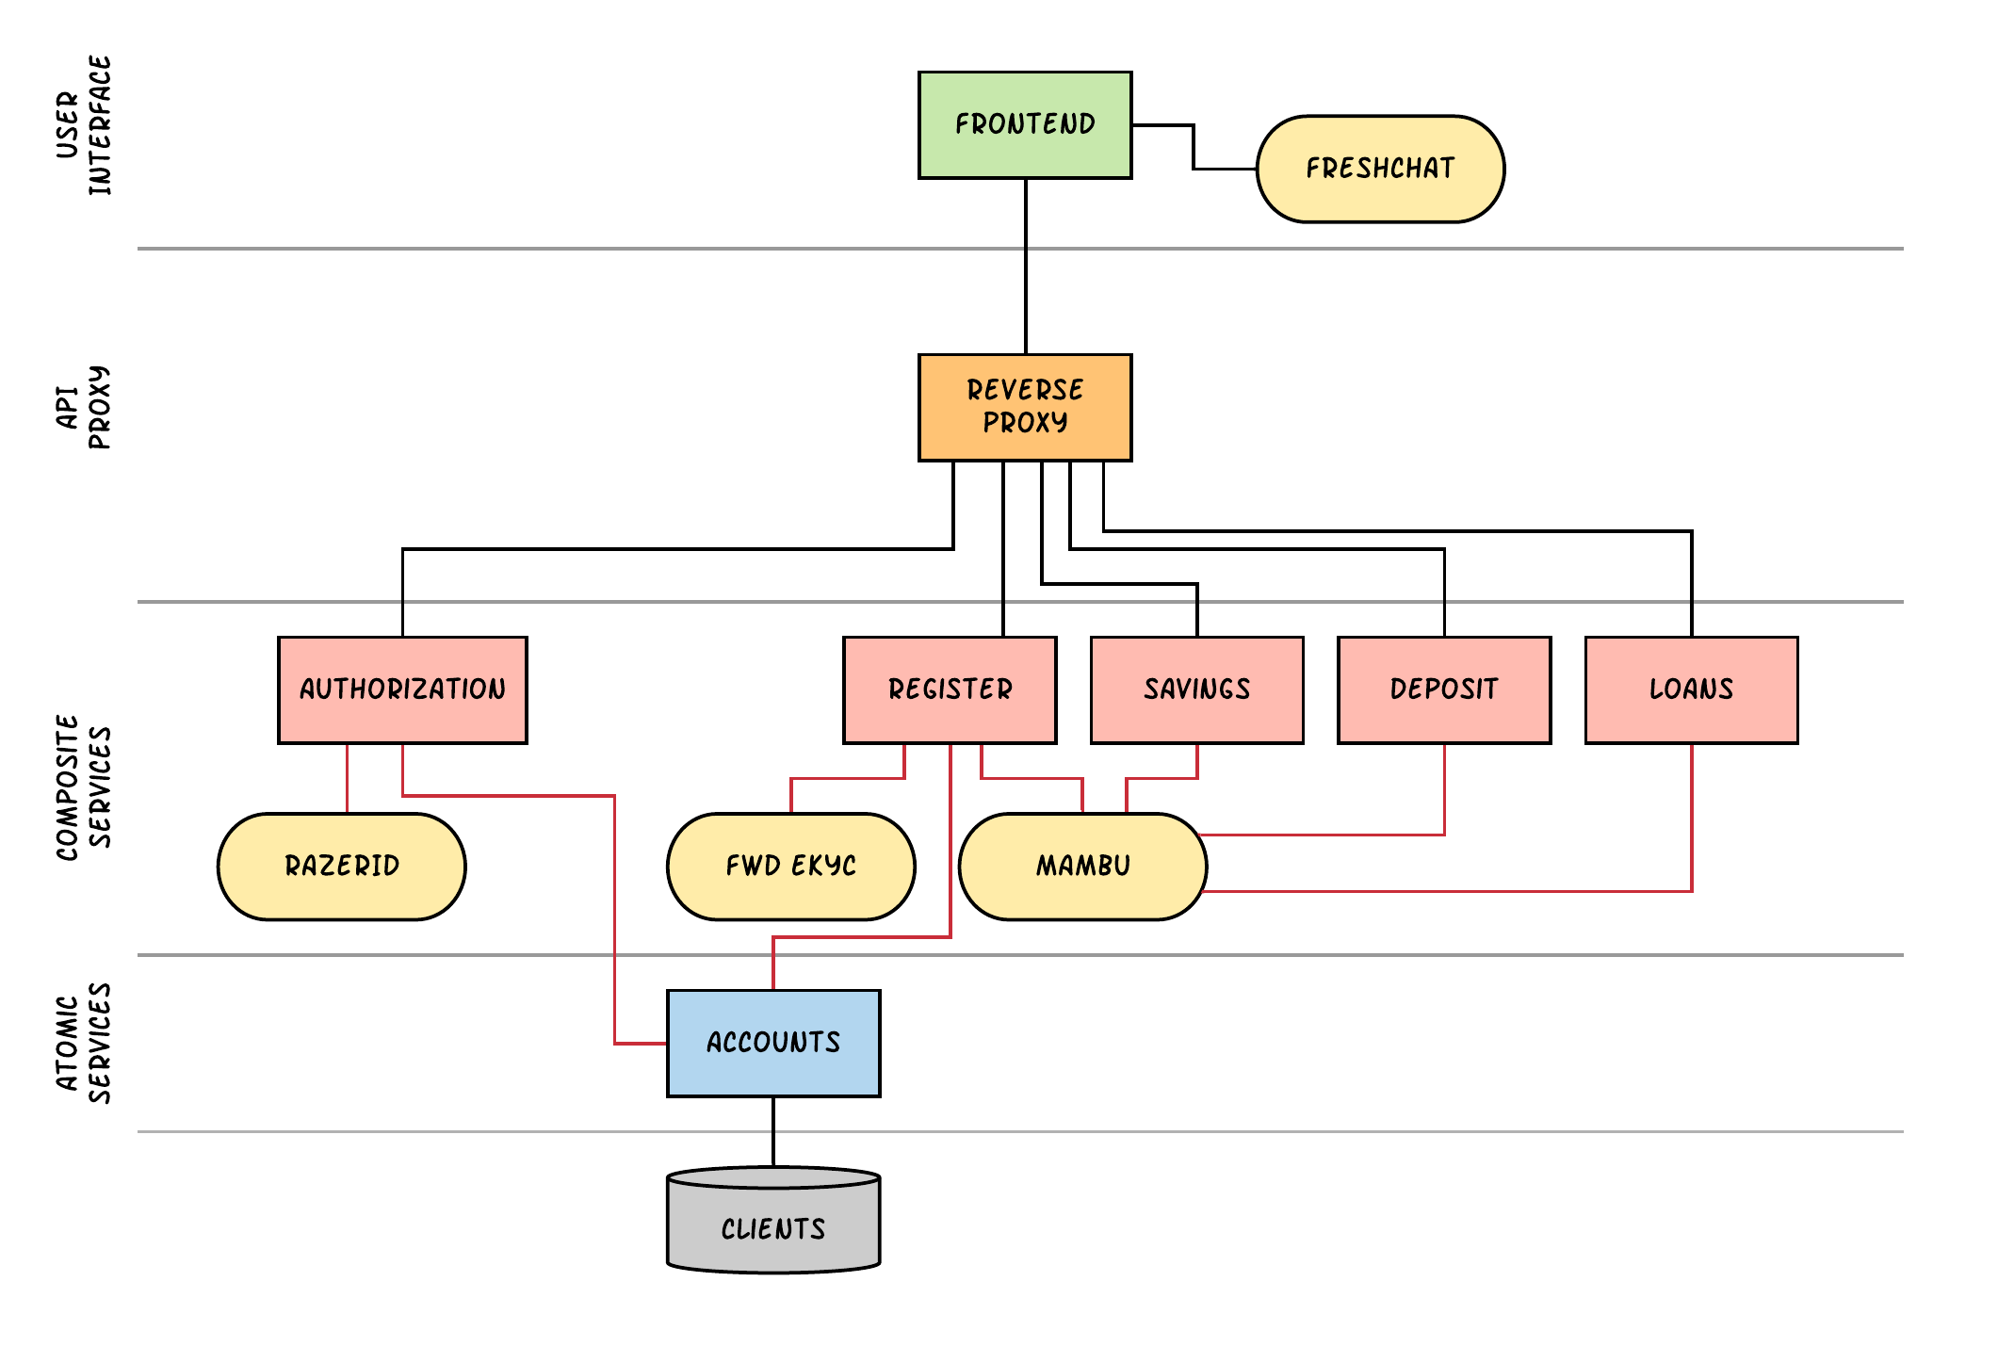
proposed layered service oriented architecture

Slide 10
Future extensions?
pseudo Credit Card
integrated gamification
Integrate Razer Pay
Issue card numbers that masks real card identify to enhance assurance of card information confidentiality
Include activities or campaign which compels existing clients to use the platform consistently
What is a Razer Bank without Razer Pay?

